Slide 1

Drug side effect predictor

Slide 2
agenda
Problem Statement – Identifying the need for predicting drug side effects
and medical conditions.
Exploratory Data Analysis (EDA) – Understanding data distribution, trends,
and key insights.
Model Building – Training machine learning models for side effect and
condition prediction.
Deployment – Developing and deploying an interactive Stream-lit web application.
Conclusion & Future Work – Evaluating results and discussing
improvements.

Slide 3

Problem statement
DRUG SIDE EFFECT PREDICTOR
MACHINE LEARNING PROJECT
OVERVIEW
The goal is to analyze the relationships between drugs, their side effects, and the medical conditions they treat, as well as to explore the ratings and reviews associated with these drugs
Patients and healthcare providers need a reliable way to predict possible side effects and medical conditions from drug usage.
This project uses data analysis (EDA), machine learning models, and deployment in a Stream-lit app to provide accurate predictions, with automated report generation for decision support.

Slide 4
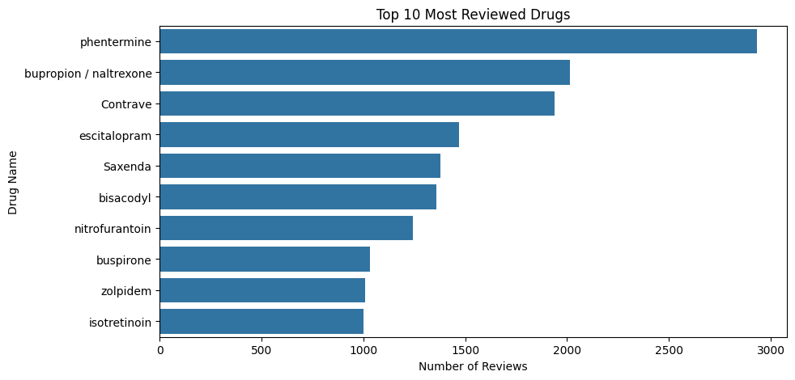
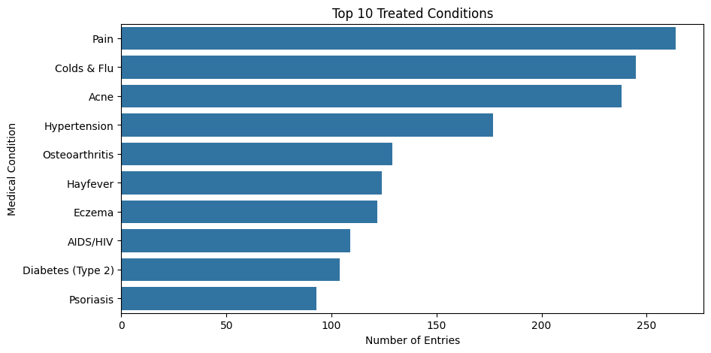
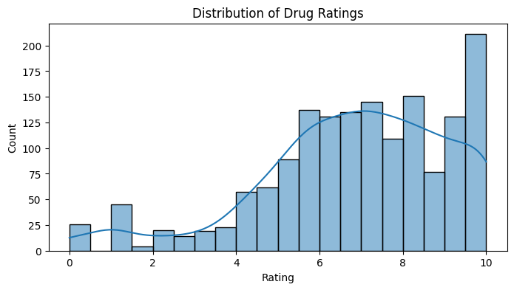
EDA
Phentermine has the most reviews, followed by bupropion/naltrexone and Contrave — indicating these are the most commonly used or discussed drugs in the dataset.
Most drugs received **high ratings**, especially **10**, indicating overall **positive user experiences** with the medications.
Pain, colds & flu, and acne are the most commonly treated conditions, highlighting these as key focus areas in the dataset.

Slide 5
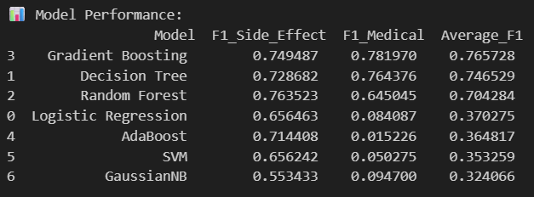

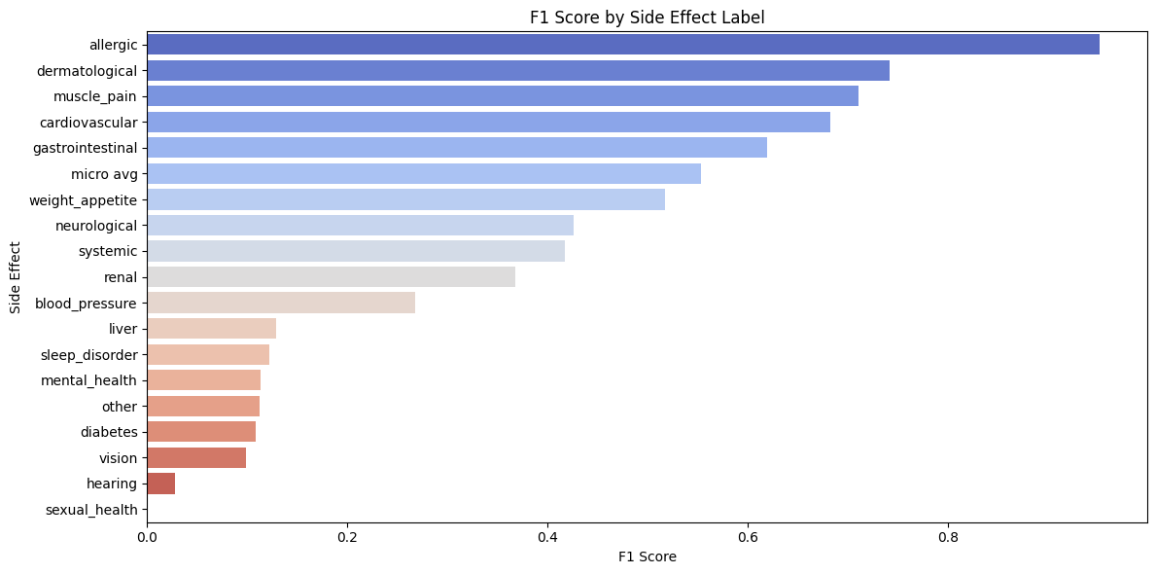
Model building
MODEL-Gradient Boosting

Slide 6
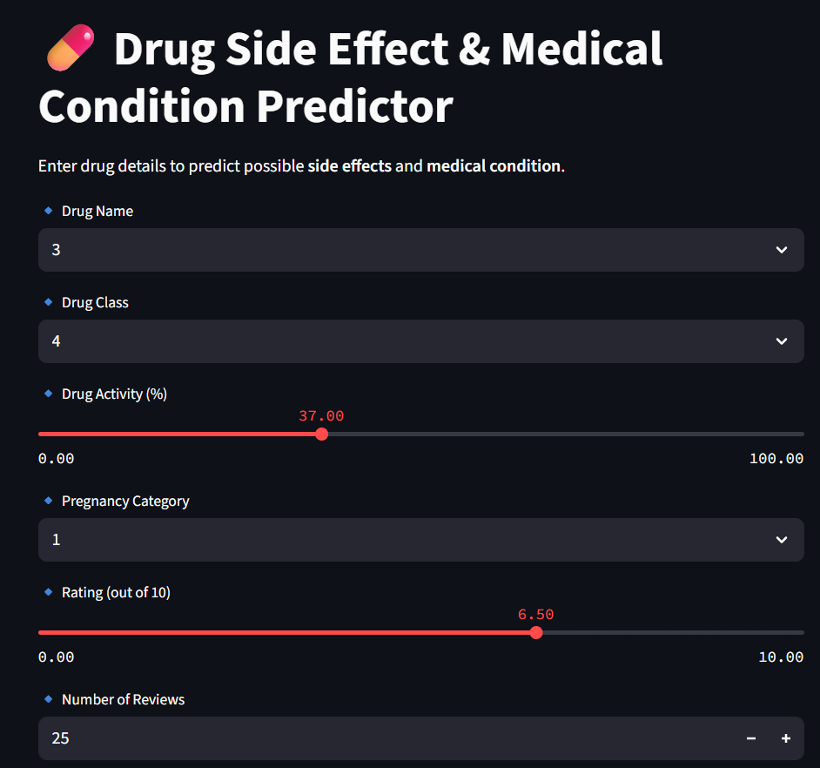
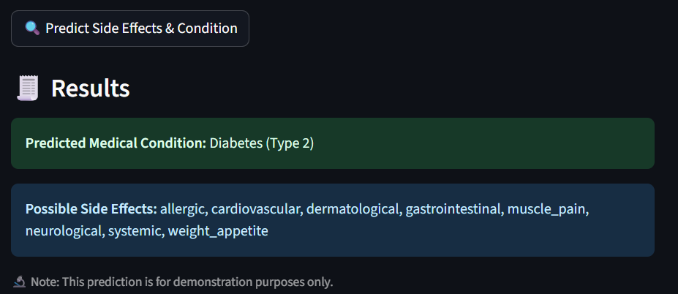
DEPLOYMENT

